Slide 1
Tools for flutter

Slide 2
Black box AI
Blackbox AI is an artificial intelligence-powered extension for Visual Studio Code that aims to enhance coding productivity and efficiency.
It leverages a large language model (LLM) trained on massive amounts of code to provide intelligent code completions, suggestions, and responses to natural language queries.
It's a relatively new tool, but it's gaining popularity due to its potential to streamline development workflows.

Slide 3
Key Features
AI-powered code completion: Blackbox AI suggests code snippets as you type, tailored to your current context and coding style.
Code chat: Ask questions in natural language, and Blackbox AI will respond with relevant code snippets or explanations.
Code search: Quickly find code examples from various sources, including public repositories, documentation, and your own codebase.

Slide 4
Flutter Flavorizer
Flutter Flavorizer is a powerful and free package for Flutter developers that simplifies the creation and management of flavors within your app.
Traditionally, setting up and managing flavors in Flutter can be quite tedious and involve manual edits across various files. But Flutter Flavorizer automates much of this process, making it significantly easier and faster.

Slide 5
Key features
Create flavors with ease: Define your flavors in a centralized YAML file, specify customizations, and let Flavorizer handle the rest.
Automatic build configurations: Flavorizer generates different build configurations (e.g., development, staging, production) for each flavor.
Firebase integration: Configure and manage Firebase configurations for each flavor with dedicated sections.
Easy customization: Extend Flavorizer's functionality with custom generators and plugins to tailor it to your specific needs.

Slide 6
Bito AI
Bito's AI code assistant simplifies, accelerates, and enhances coding experiences like never before. It comprehends codebases, leveraging the power of OpenAI's ChatGPT, GPT-4, Google's chat-bison, and comparable models. It revolutionizes developers' coding processes by effortlessly generating high-quality, AI-powered code, providing code completions, explaining intricate code segments, generating unit tests, documentation, and more. Bito's AI code assistant makes coding a seamless and enjoyable endeavour for developers.
Bito boasts an active user base of 100,000 developers, including professionals from industry giants such as Amazon, Apple, Google, Tesla, Airbnb, Salesforce, Cisco, Nvidia, and Adobe.

Slide 7
Key features
Work on your code with AI that knows your code
Get AI-powered code completions, right within your IDE
Ask follow-up questions to refine the output
Control code changes: Review, accept & reject
View and continue past chat conversations
Chat in your preferred local language
Robust data privacy: Your code remains private

Slide 8
Tabine AI
Tabnine is an AI code assistant that accelerates development with real-time code completions, chat, and code generation across popular languages and IDEs. Whether it's IntelliSense, autocomplete, or AI-assisted code completion, Tabnine significantly cuts down coding time, making it a powerful tool for developers.
Tabnine Chat is a secure AI assistant, exclusively trained on permissible open-source code, providing private support directly within your IDE. It allows you to ask a wide range of code-related questions, such as generating code for specific tasks, creating tests, generating documentation, or explaining the purpose of legacy code, enhancing your coding experience.
Has 3 million + installations in android studio

Slide 9
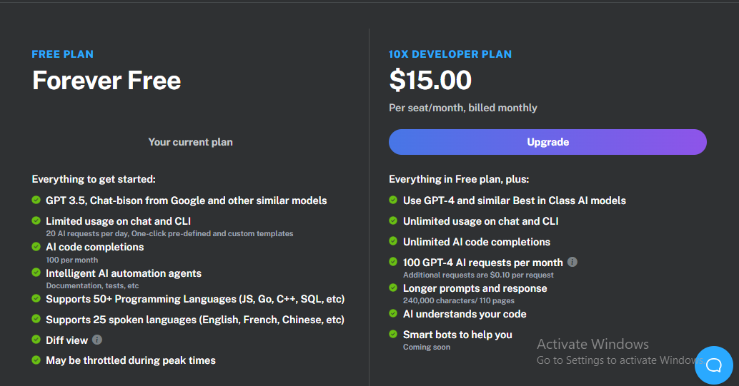
PRICING - bito

Slide 10
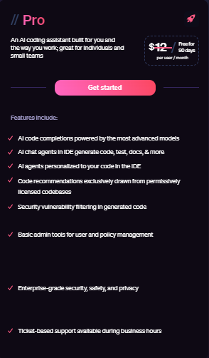


PRICING - tabine

Slide 11

DEMO

Slide 12
Flutter tools for security
Flutter Secure Storage
Flutter Secure Storage provides API to store data in secure storage. Keychain is used in iOS, KeyStore based solution is used in Android.
This flutter secure storage is more likely similar to Shared Preferences but the difference is that, this flutter secure storage has an additional layer of security.
Using flutter secure storage, we can store all data types including String, int, double, bool, List<String> etc., locally inside our flutter app.
AES encryption is used for Android. AES secret key is encrypted with RSA and RSA key is stored in KeyStore
Keychain is used for iOS

Slide 13
Flutter tools for security
flutter_jailbreak_detection
Identifies jailbroken or rooted devices, allowing for tailored security responses.
Flutter jailbreak and root detection plugin. This plugin wraps Rootbeer for use on Android and DTTJailbreakDetection for use on iOS.
html_unescape
Safely decodes HTML entities,
Helps in preventing XSS attack
How it works:
Converts HTML-encoded characters back to their original form for proper display.
Thoroughly sanitizes input to ensure only valid characters are decoded.
Blocks malicious code injection attempts through encoded entities.

